Slide 1

GRAPH THEORY AND ITS APPLICATIONS
Dr. Arti Arya
Department of Computer Science & Engineering

Slide 2
GRAPH THEORY AND ITS APPLICATIONS
Graph Applications
Dr. Arti Arya
Department of Computer Science & Engineering

Slide 3


Graph Theory and its Applications
Chinese Postman Problem
In 1962 Chinese mathematician, Kwan Mei-Ko was interested in a postman delivering mail.
It is the problem that the Chinese Postman faces: he wishes to travel along every road in a city in order to deliver letters, with the least possible distance.
The problem is how to find a shortest closed walk of the graph in which each edge is traversed at least once, rather than exactly once.
In graph theory, an Euler cycle in a connected, weighted graph is the solution to Chinese Postman problem.

Slide 4
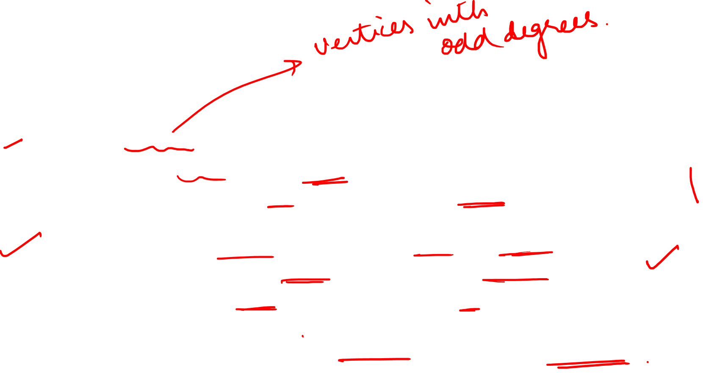
Graph Theory and its Applications Chinese Postman Problem
An algorithm for finding an optimal Chinese postman route is:
Find all odd vertices in the graph.
Find all possible pairings of odd vertices.
For each pairing find the edges that connect the odd vertices with the minimum weight( shortest path possible).
Find the pairings such that the sum of the weights is minimised.
On the original graph add the edges that have been found in Step 4.
The length of an optimal Chinese postman route is the sum of all the edges added to the total found in Step 4.
A route corresponding to this minimum weight can then be easily found.

Slide 5








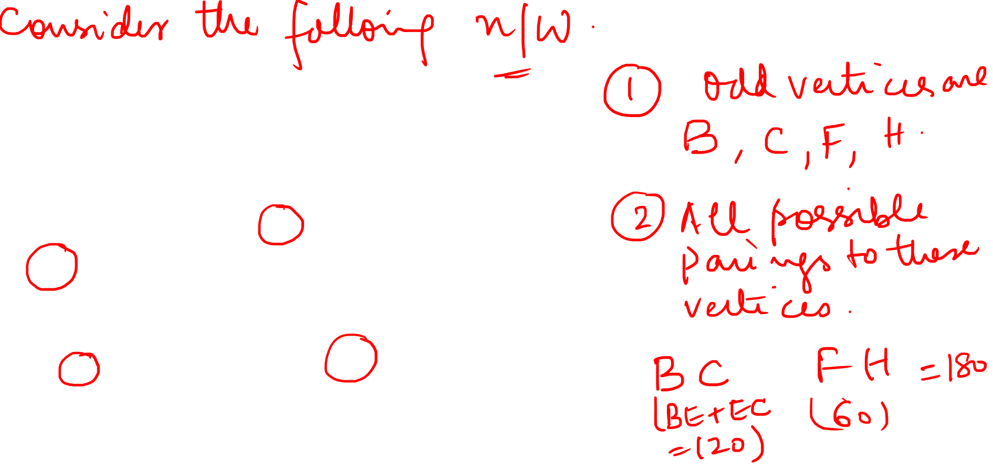












Slide 6
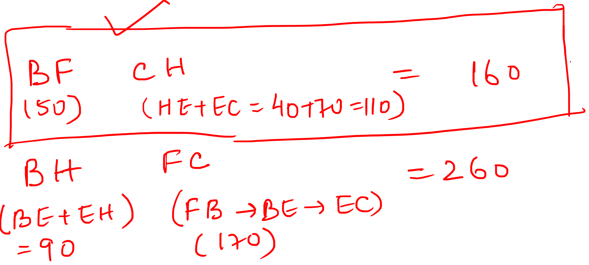

Slide 7
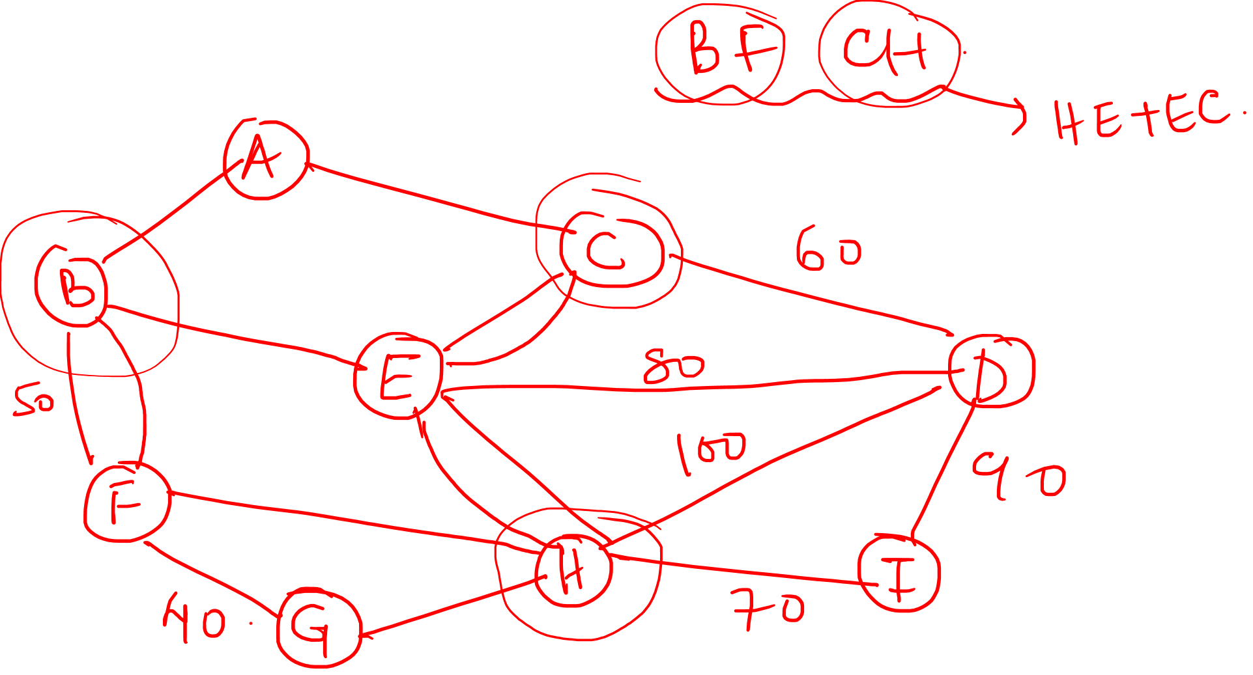

Slide 8
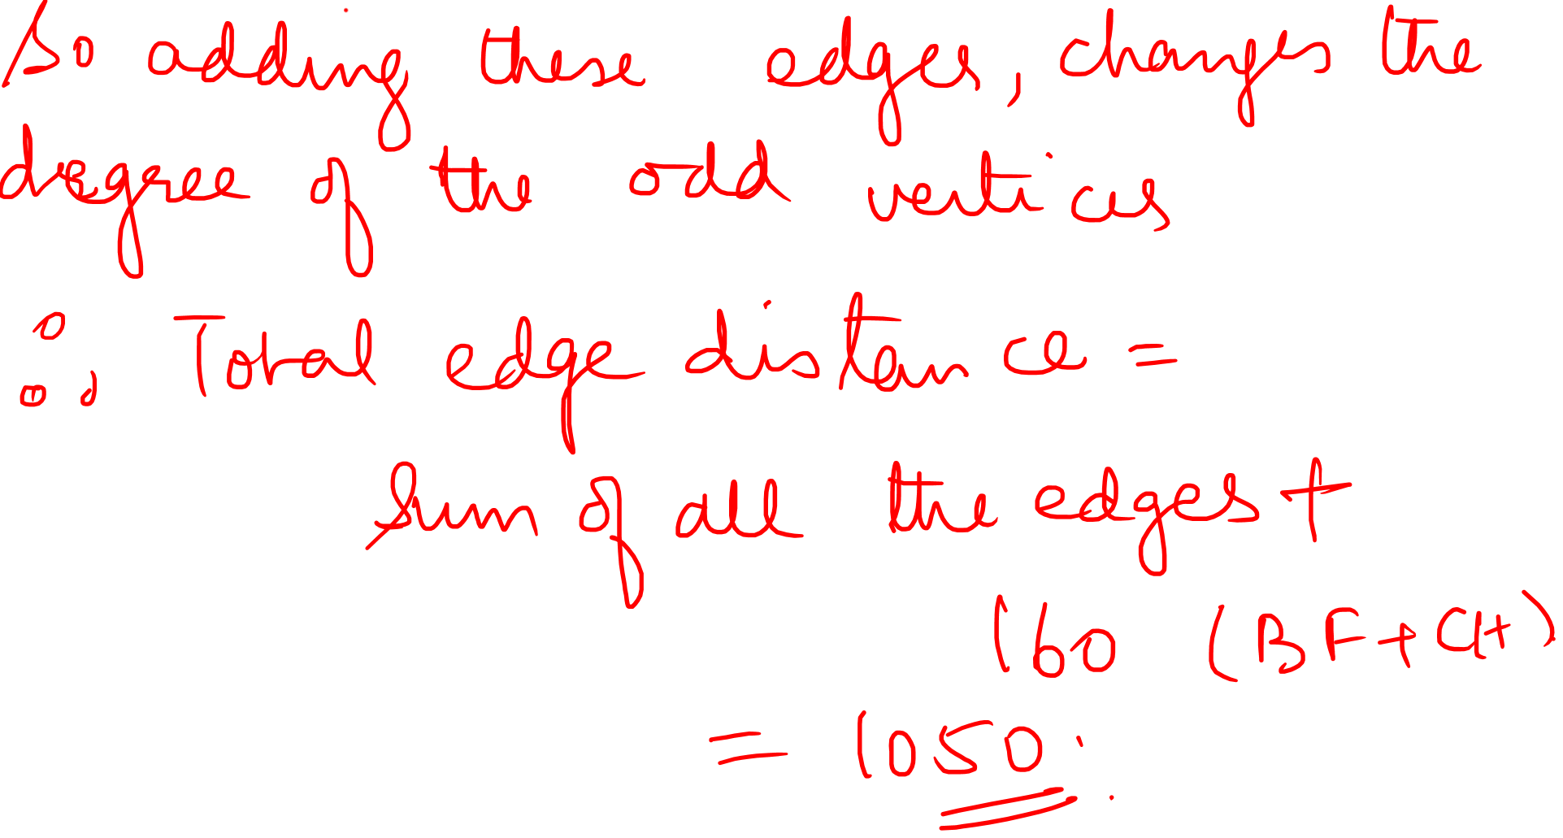

Slide 9
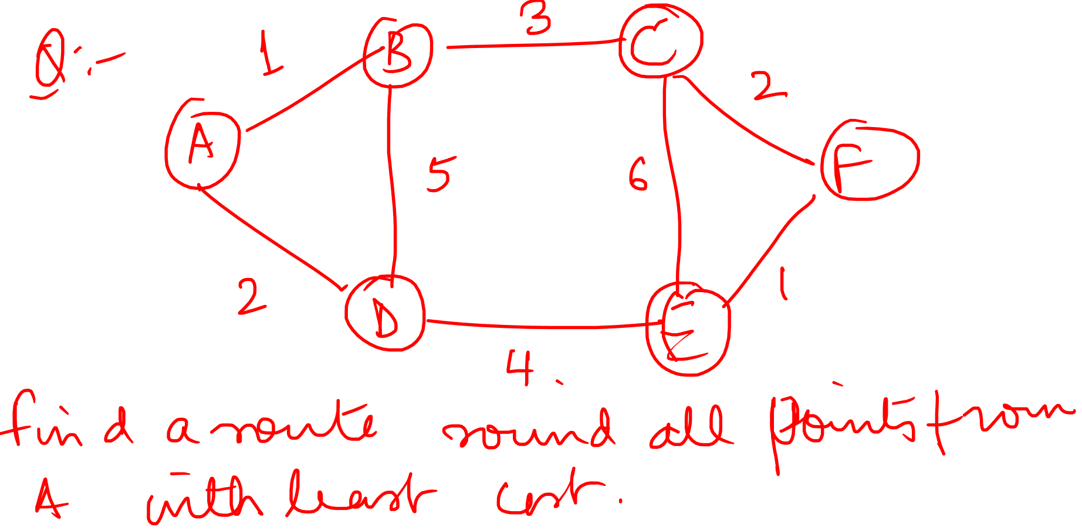

Slide 10
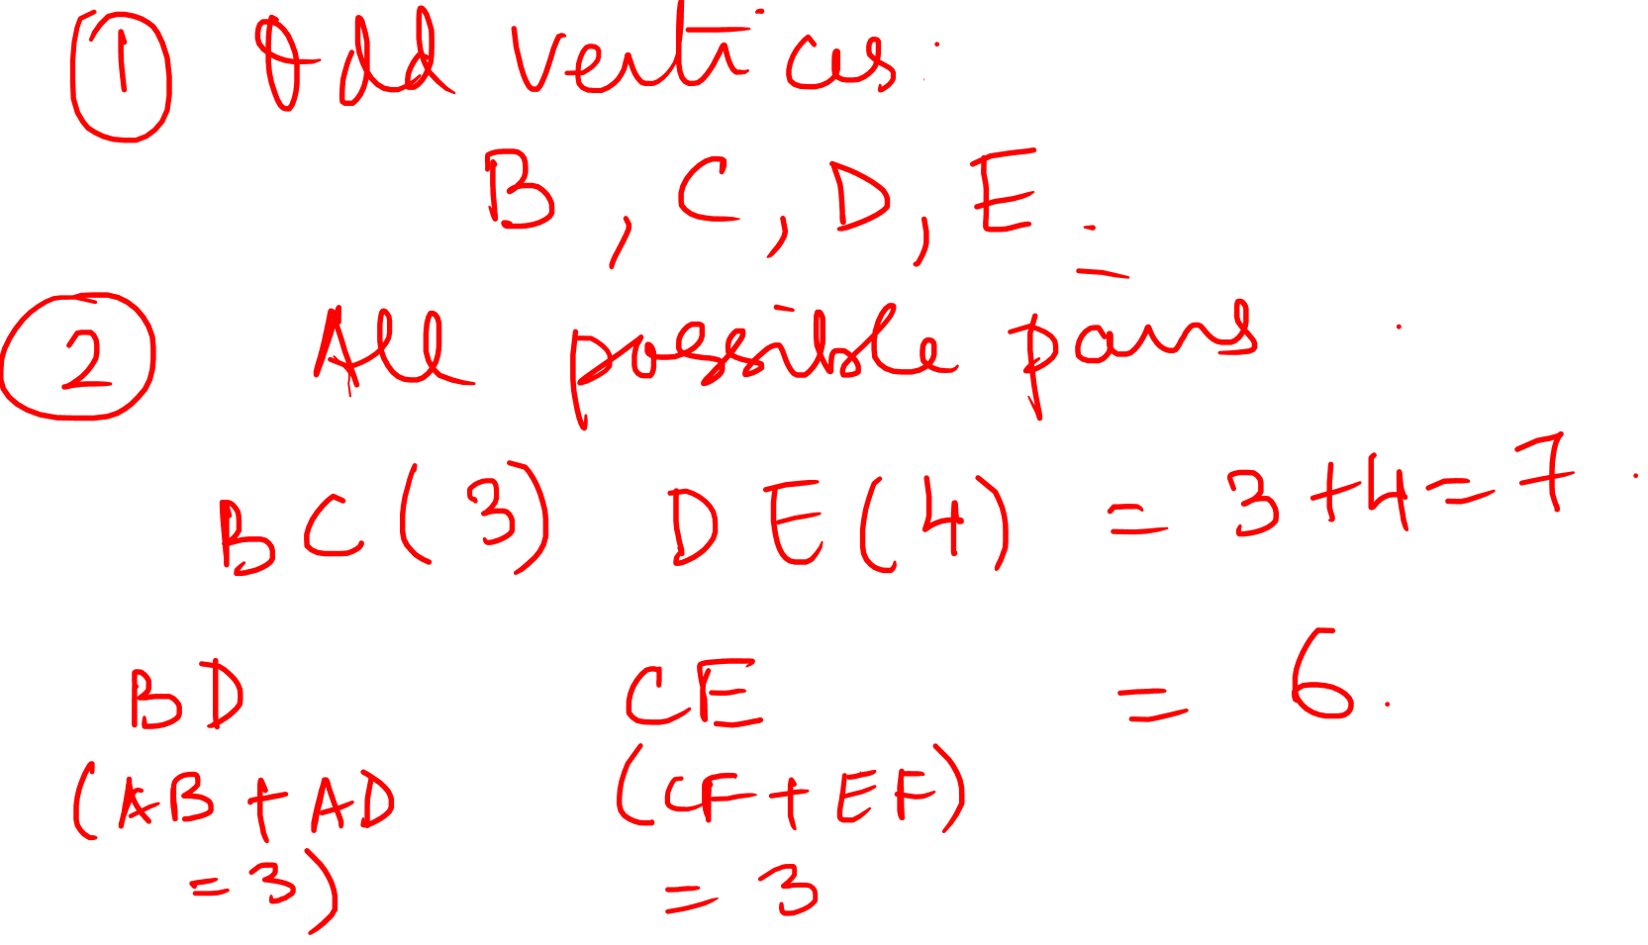

Slide 11
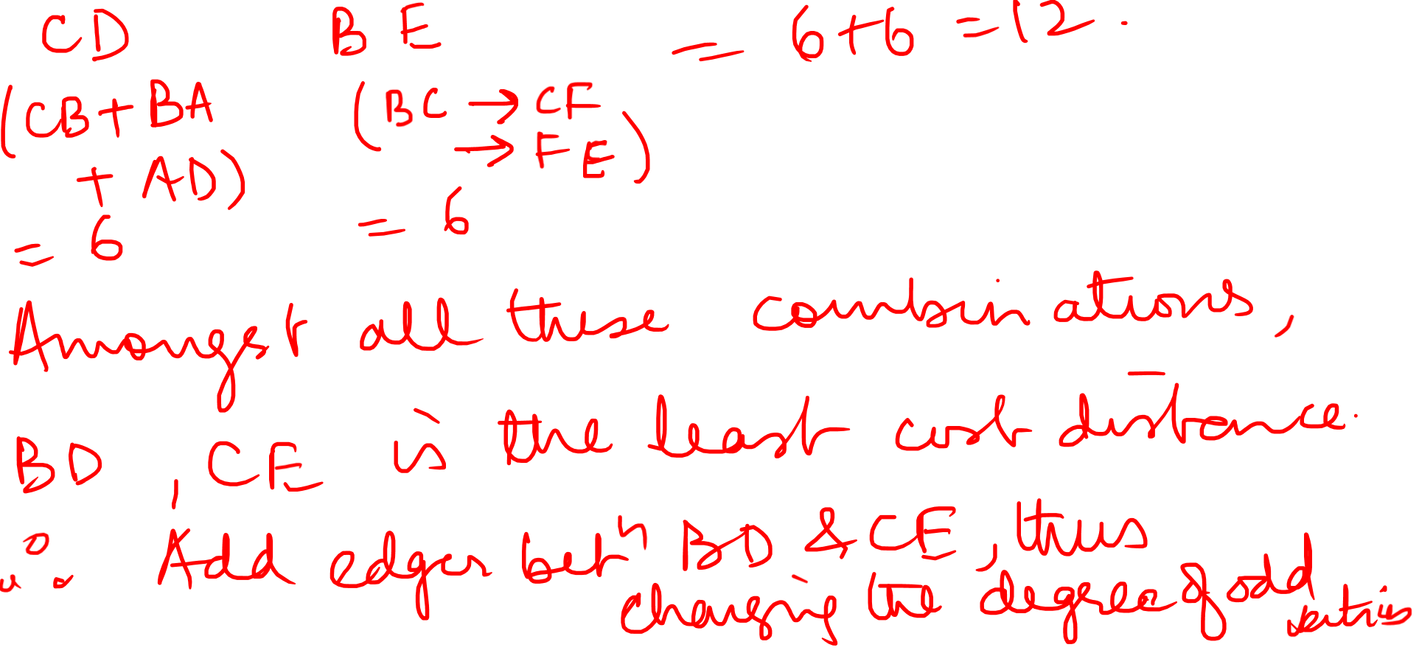

Slide 12
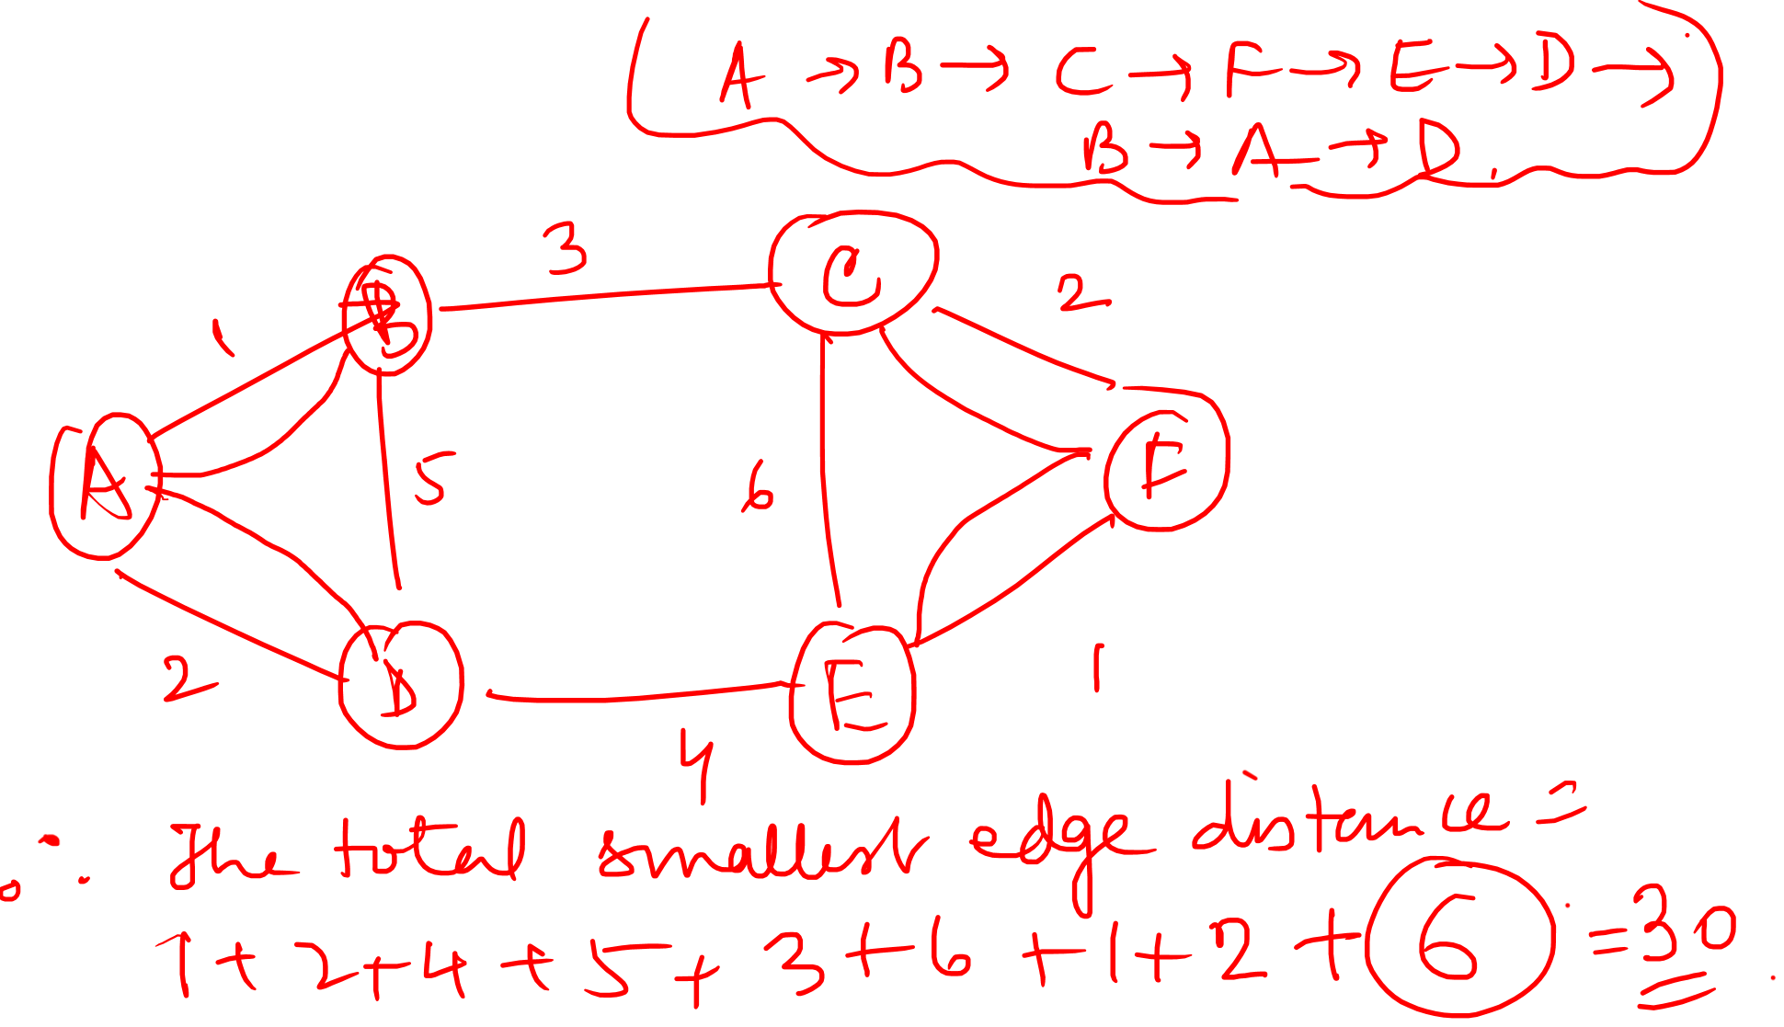

Slide 13
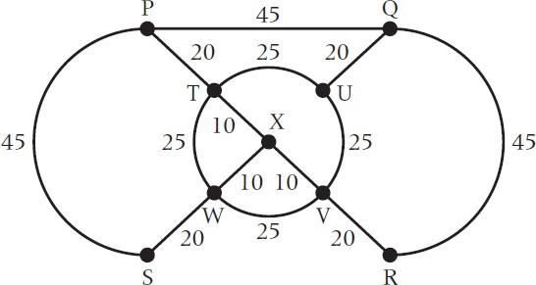
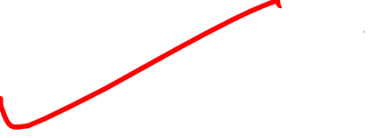
Graph Theory and its Applications Chinese Postman Problem
The vertices of the following network represents the chalets in a small holiday park and the arcs represent the paths between them with the lengths of the paths given in meters. A gardener wishes to sweep all the paths starting and finishing at P and to do so by walking as short distance as possible. Apply Chinese postman algorithm to find the shortest distance the gardener must walk and gives shortest possible route.

Slide 14



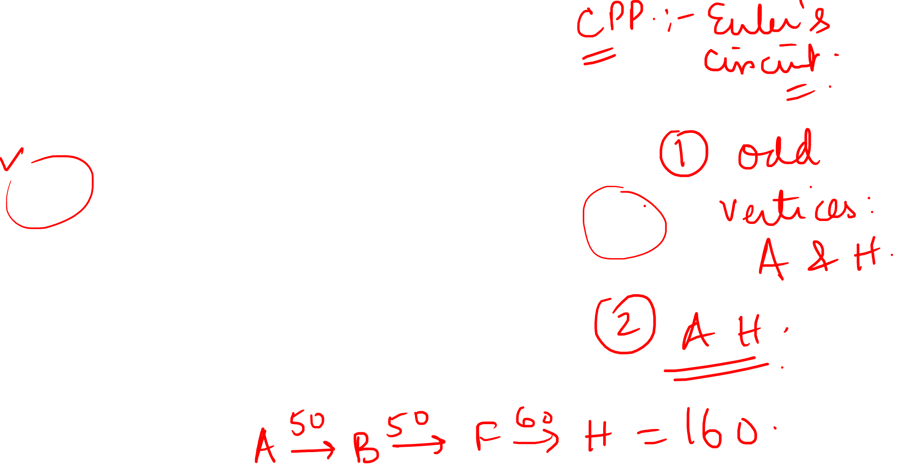
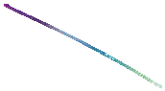





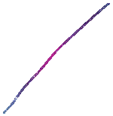















Slide 15
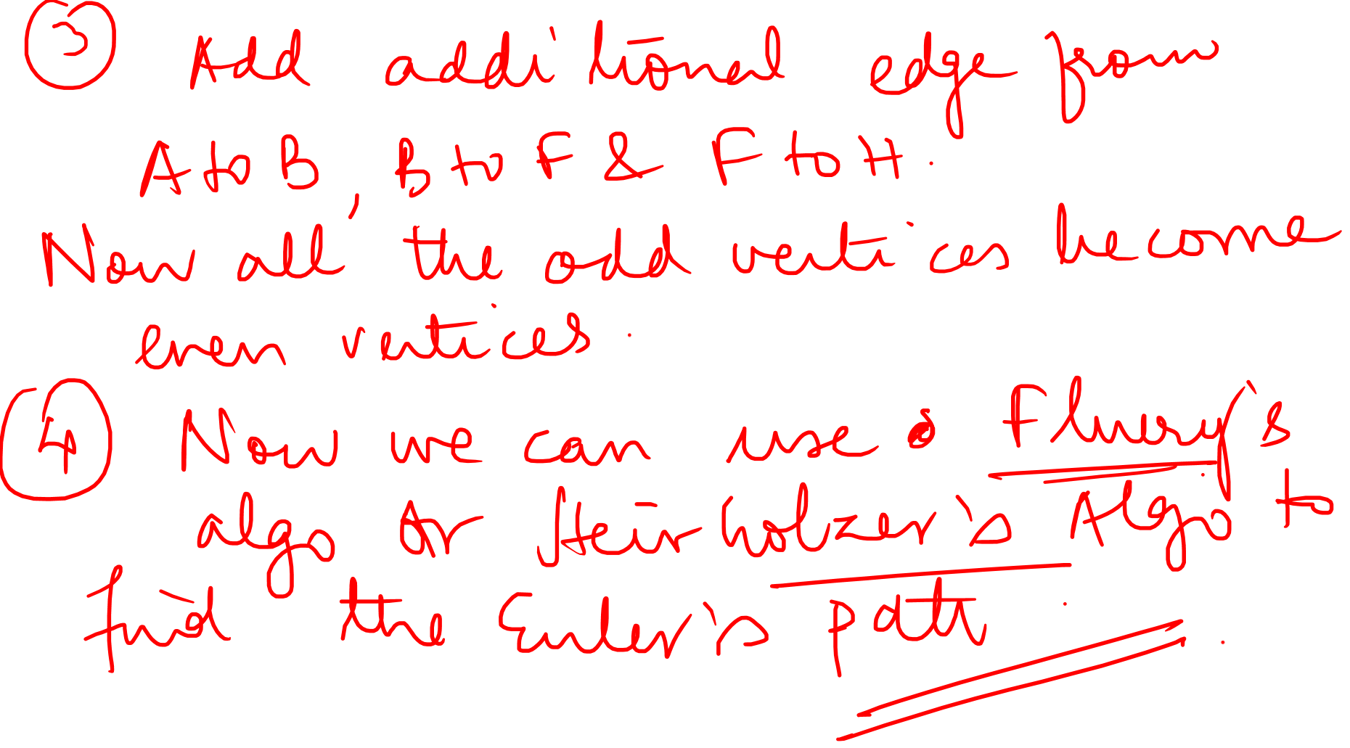

Slide 16
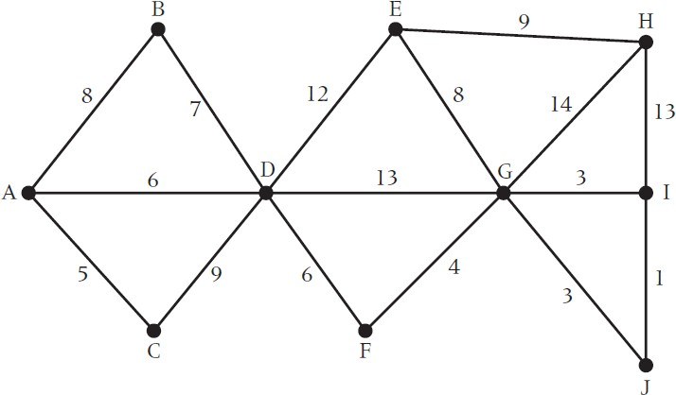
Graph Theory and its Applications Chinese Postman Problem
A police motor cyclist based at town A has to travel along each of the roads atleast once before returning to base at A. Find the minimum total distance the motor cyclist must travel.

Slide 17
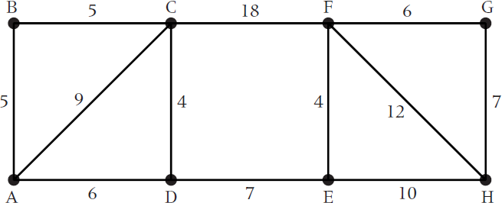
Graph Theory and its Applications Chinese Postman Problem
Find the length of the optimal Chinese postman route for the network below

Slide 18
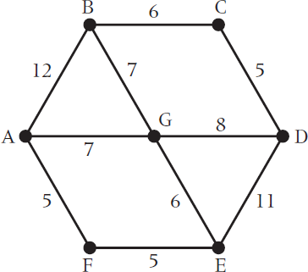
Graph Theory and its Applications Chinese Postman Problem
Find the length of the optimal Chinese postman route for the network below

Slide 19
THANK YOU
Dr. Arti Arya
Department of Computer Science &Engineering

